Slide 1
IR REMOTE EMULATOR
SUBMITTED BY:
SUGANTH KRISHNA E 20502369
GUIDE: Mr.V.Sreetharan, M.E., M.B.A..,

Slide 2
ABSTRACT
The purpose of this tool is to control an IR remote handled device using a mobile phone with Bluetooth compability.
The device must be configured first before the implementation .
The IR signals from remote to be used with actual device must be captured and stored .
The device is placed between 5m range and connected via Bluetooth and the provided application in mobile phone.

Slide 3
EXISTING SYSTEM
IR based Remotes gets easily blocked by simple objects like notebooks,wall etc…..,
Specific mobiles which contain IR transmitter can only be used for remote operation.
Devices available similar to this contain only limited number of popular remotes supported.
The storage and retrieval options are not available in previous versions.

Slide 4
PROPOSED SYSTEM
The purpose of this tool is to control an IR remote handled device using a mobile phone using Bluetooth.
This makes the controlling of any component easier and handy.
The IR signals from remote to be used with actual device will be captured and stored .
The previous remotes used can be stored using the provided mobile application.
The remotes used can be named and configured easily using the application.

Slide 5
ADVANTAGES
Easier and simple to configure.
More portable due to light weight.
Small and handy device which do not consumes more power.
Universal capability of configuring any remotes and using it.
Storage and retrieval operations on database on the connected mobile phone via application.
Makes user free of managing multiple remotes.

Slide 6
HARDWARE REQUIREMENTS
Processor : Intel Core i3 Processor
RAM : 4 GB
Hard Disk Drive : 500 GB
Monitor : 17" Color Monitor
Arduino Uno : 1 No.
General Purpose Transistor NPN : 1 No.
Resistor 1k ohm : 1 No.
Bluetooth Low Energy Module : 1 No.
Infrared Emitter : 1 No.
Infrared Receiver 38 kHz : 1 No

Slide 7
SOFTWARE REQUIREMENTS
Operating System: Windows 7 and higher
Front End: Arduino IDE
Applications: Arduino IR Kit(Android) Arduino IR Kit(iOS)

Slide 8
CONCLUSION
Reduces the difficulties of using an ordinary IR remote.
Multiple remotes and maintenance is avoided.
Towards a smarter world with help of technology.

Slide 9
FUTURE ENHANCEMENTS
Auto configuring of remotes using data from internet.
Data’s can be published on internet for further usage.
Voice based controlling of components.

Slide 10
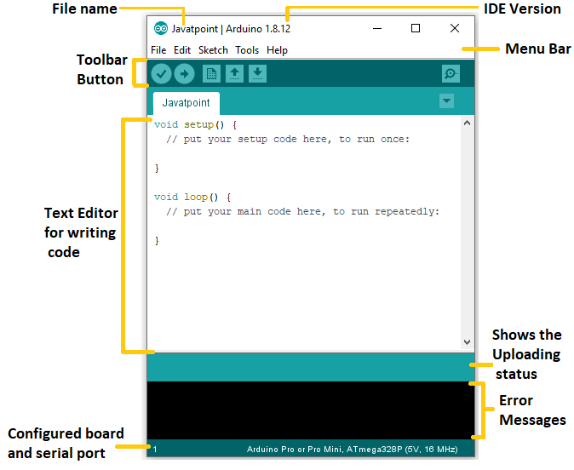
SCREENSHOTS

Slide 11
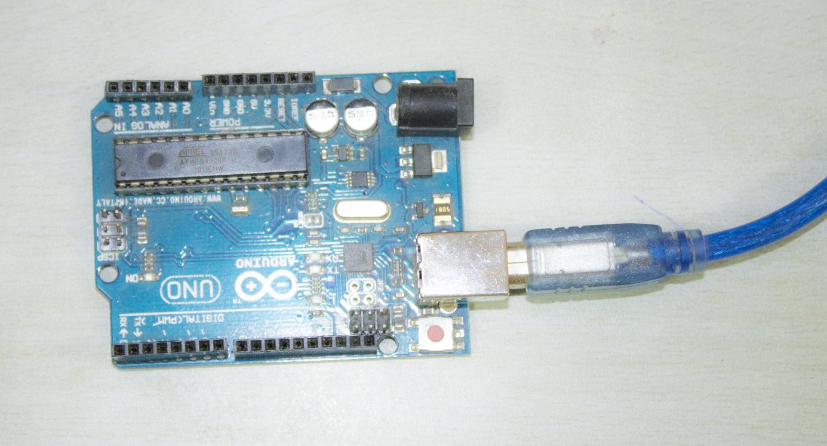
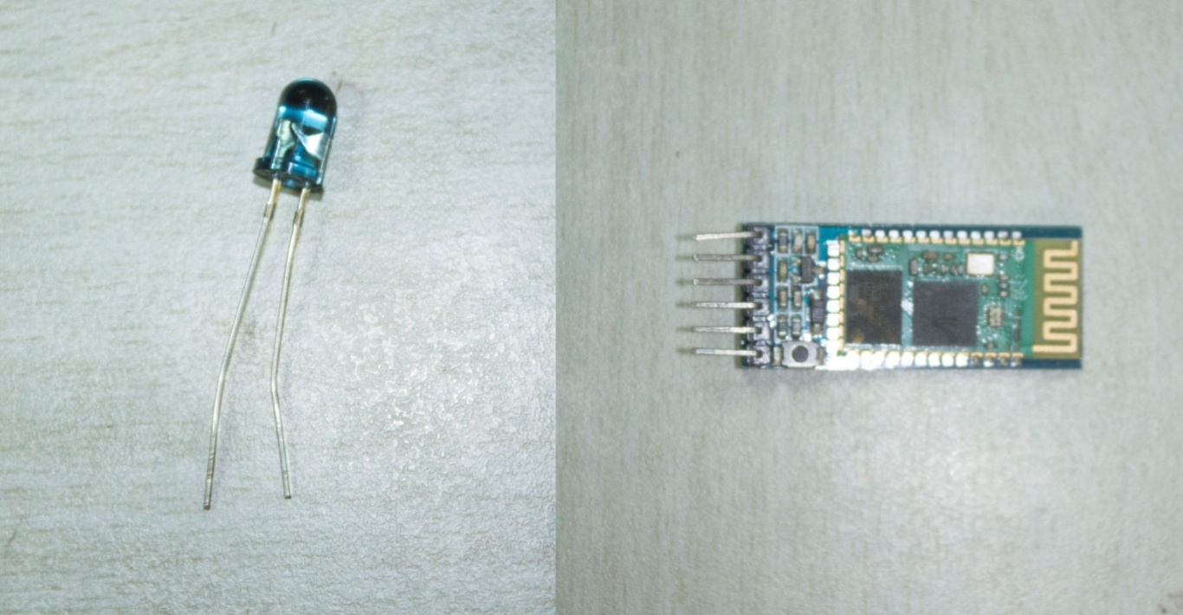

Slide 12
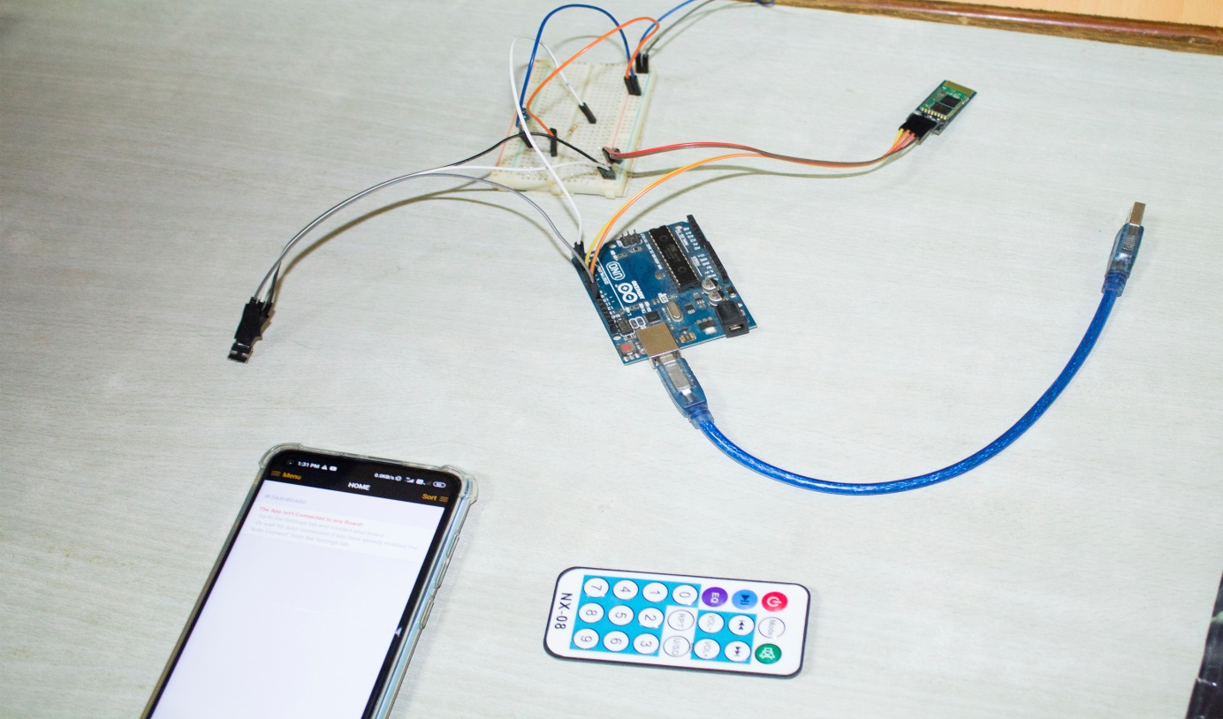
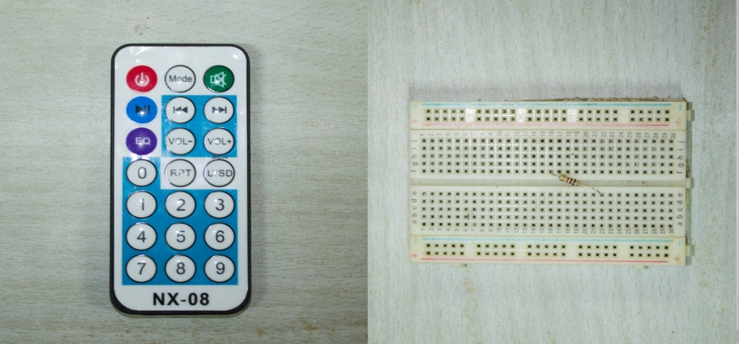

Slide 13
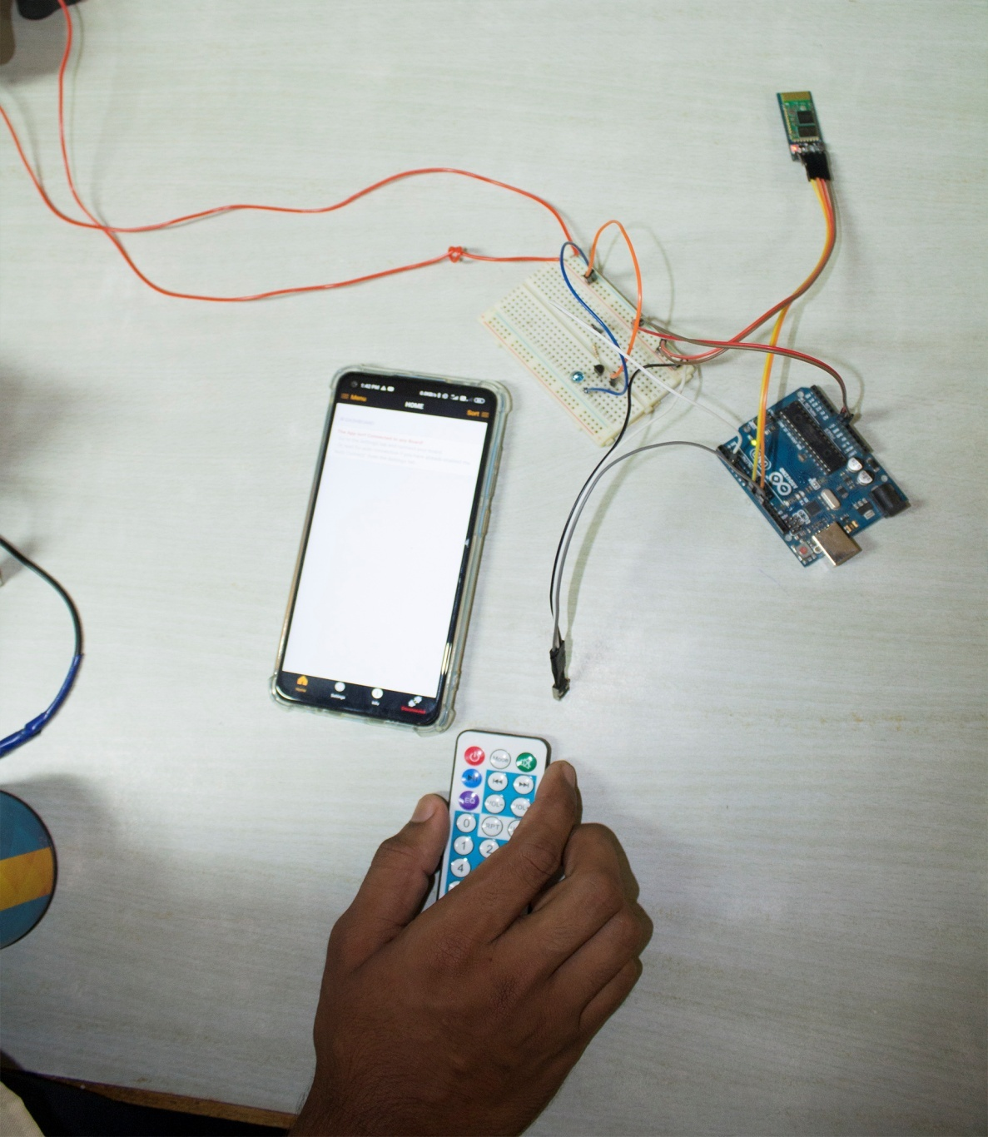

Slide 14


